Slide 1
Wrangle PDFs on the Web Like a Pro!
Raymond Camden | Senior Developer Evangelist

Slide 2

Who am I?
Raymond Camden
Developer Evangelist for the Document Services Team
Blogging at raymondcamden.com
Tweeting at @raymondcamden
Getting too many emails at jedimaster@adobe.com

Slide 3
What's the Problem?

Slide 4
PDF Support on the Web
Browsers can render PDFs (Good!)
Browsers each have their own "flair" (Um, ok)
Inconsistent tooling, UI, UX, more U words (Not terribly good)
Completely leaves your site (Can I speak to the manager?)

Slide 5

PDF Examples - Safari

Slide 6
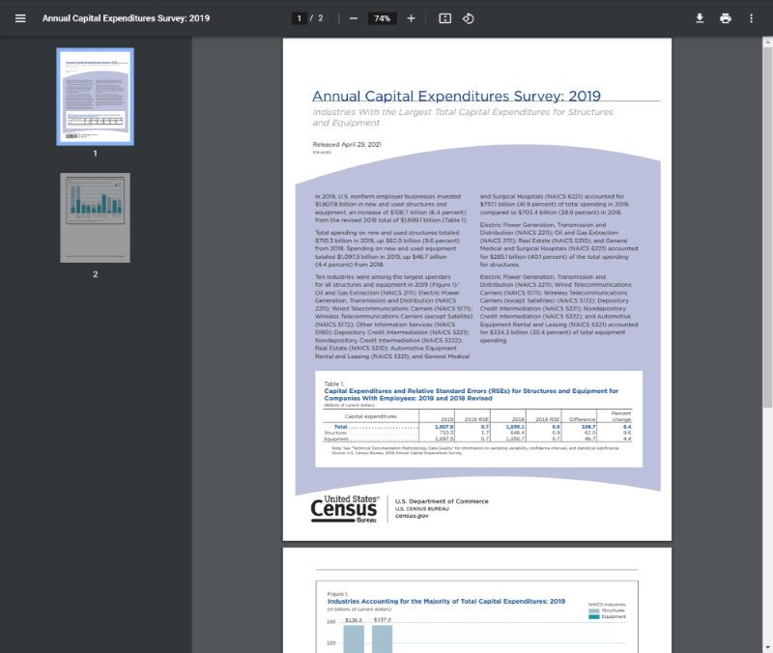
PDF Examples - Chrome

Slide 7
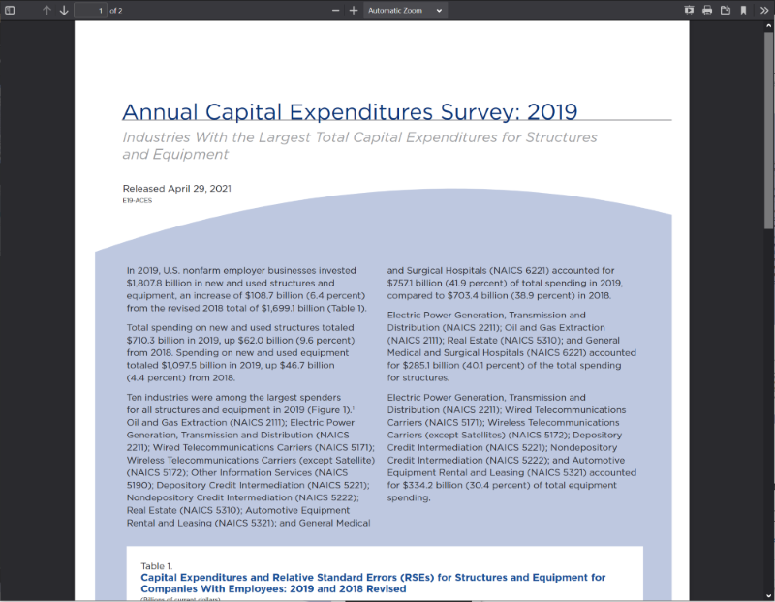
PDF Examples - Firefox

Slide 8
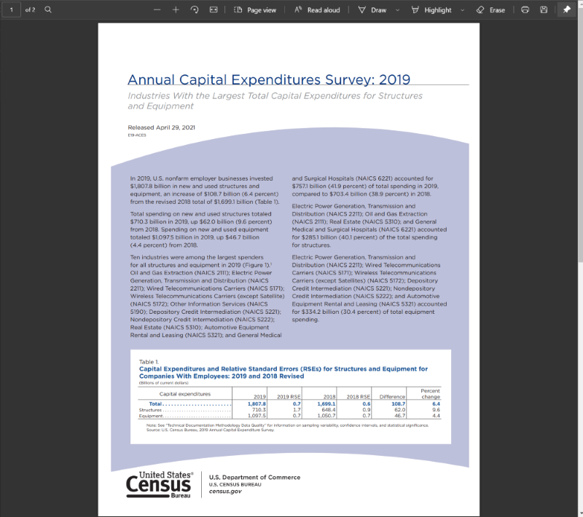
PDF Examples - Edge

Slide 9

Adobe PDF Embed API (to the rescue!)

Slide 10
Adobe PDF Embed API (TLDR)
JavaScript library for embedding PDFs
Gives you control over size and presentation mode
Supports annotations and comments
Gives access to analytics and events
Free

Slide 11
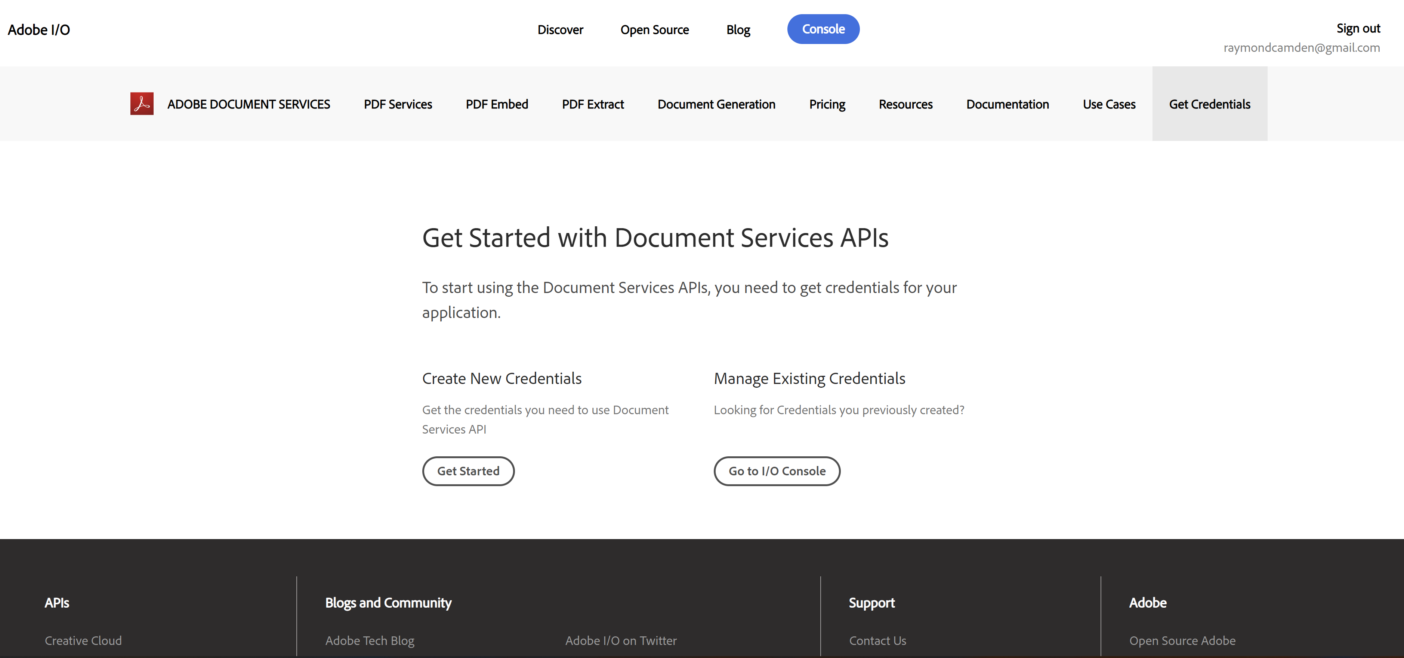
Getting Started
Ensure you've got an Adobe ID (all the cool kids do)
Sign up for a free key (https://www.adobe.io/apis/documentcloud/dcsdk/gettingstarted.html)

Slide 12
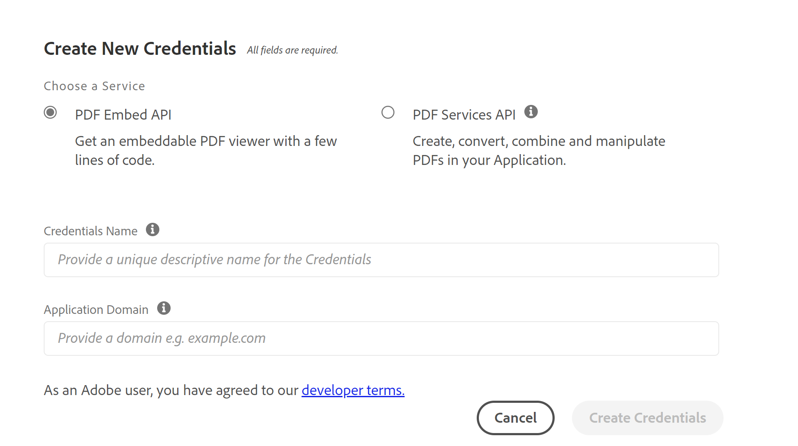
A few notes on that key...
Keys are bound by domain
You can make two keys (one for localhost, one for foo.com)
You can make a key for foo.com and use it for www., dev., local., etc

Slide 13
Using the Library
Determine where you want to load the PDF

Slide 14
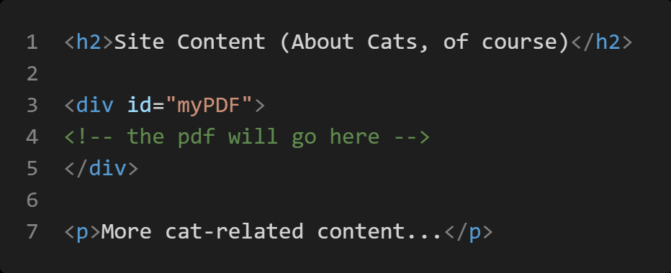

Slide 15
Using the Library
Determine where you want to load the PDF
Load the library

Slide 16
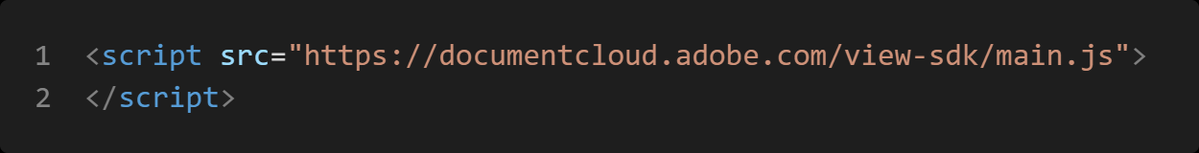

Slide 17
Using the Library
Determine where you want to load the PDF
Load the library
Check for library load

Slide 18
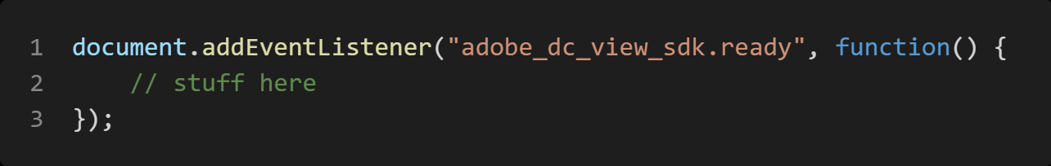
Option 1

Slide 19
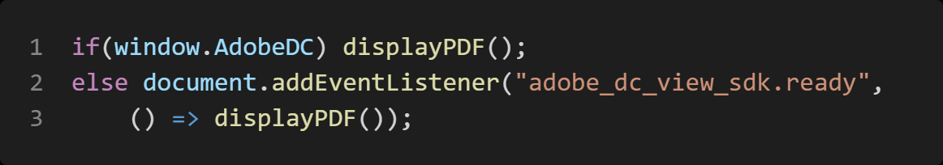
Option 2

Slide 20
Using the Library
Determine where you want to load the PDF
Load the library
Check for library load
Initialize and load your PDF

Slide 21
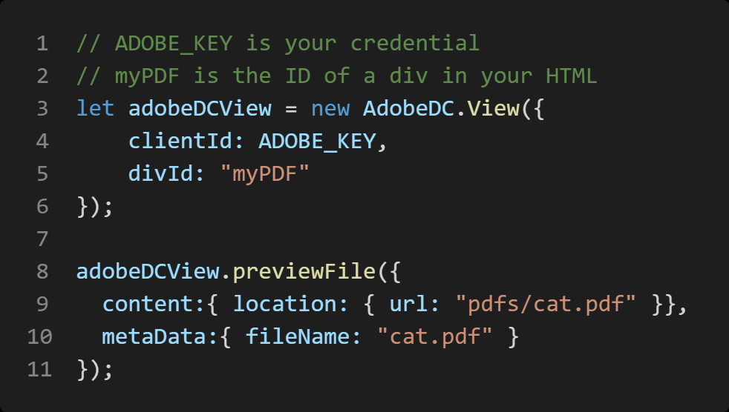

Slide 22

Demo

Slide 23
Embed Options
View options
UI control options

Slide 24
View Options
Full Window
Sized Container
In-Line
Lightbox

Slide 25
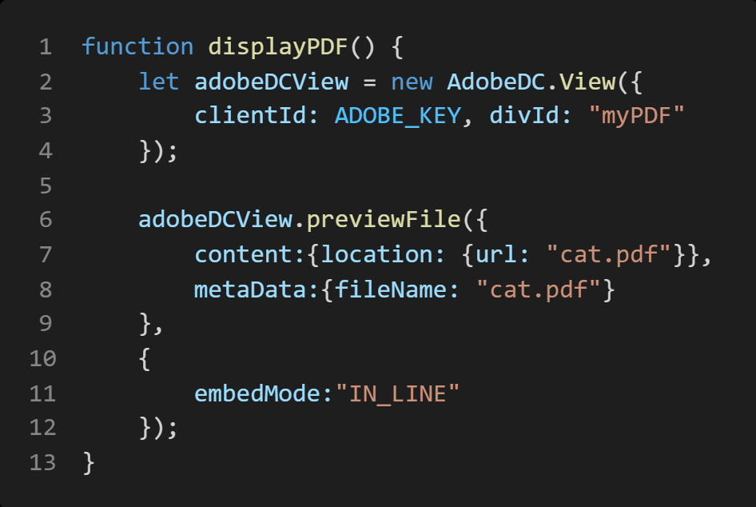

Slide 26
Demo
Notes:
Ensure you use the cool new embed demo and the cool one for lightrbox

Slide 27
UI Options
Disabling menus
Disabling panels

Slide 28
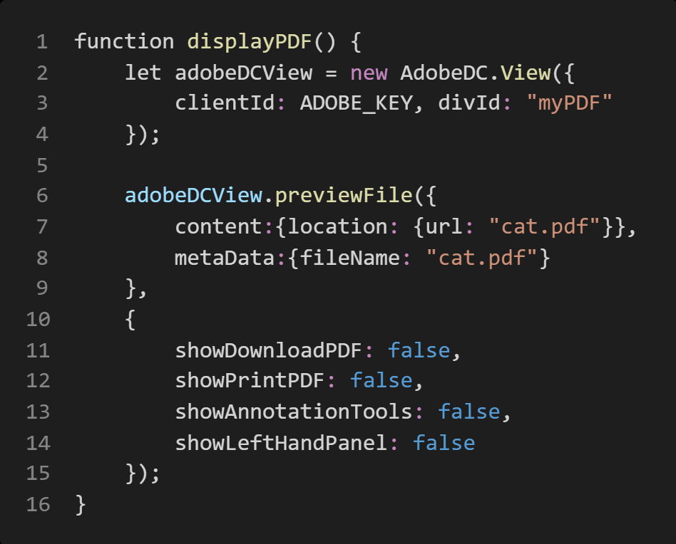

Slide 29
Demo
Notes:
Ensure you use the cool new embed demo and the cool one for lightrbox

Slide 30

Even More Features
Event handling (viewed a page, selected text, etc)
APIs to work with the embed (get selected text, etc)
Online Demo

Slide 31
























Adobe Document Services: End-to-end digital document lifecycle solutions
CREATE
SIGN
TRANSFORM
PUBLISH
EXTRACT
Document Generation API
Adobe Sign API
PDF Services API
PDF Embed API
PDF Extract API
FREE
Dynamically generate PDF and Word documents based on JSON data.
Send and capture legally-compliant e-signatures and capture web forms.
Transform PDFs such create, combine, and export to formats such as Word and other formats.
Embed PDF viewing experiences into your web apps and get analytics on your content.
Unlock data inside of PDFs and transform into JSON data.
Generate Word or PDF
Capture e-signatures
Create
Combine
Client-side rendering
AI-powered structure analysis
Conditional sections
Identity verification
Split
Export
Customizable viewing modes
Table and image extraction
Dynamic tables and lists
Embedded web forms
OCR
Protect
Comments and annotations
JSON
{;}
Data provides as JSON
Dynamic images
Send in bulk
Compress
Reorder
Analytics events
Adobe Sign-ready
Insert
Linearize
Notes:
Adobe Document Services APIs are entirely cloud-based, easy to use and deploy across different parts of a document lifecycle.
It brings some of the tools that you may be familiar with from our first-party apps as well as provides services uniquely available through API.
And we make these available through REST APIs as well as SDKs in a variety of languages.
So let’s talk about them a bit more.

Slide 32

Learn more here at Adobe Developers Live
CREATE
SIGN
TRANSFORM
PUBLISH
EXTRACT
Document Generation API
Adobe Sign API
PDF Services API
PDF Embed API
PDF Extract API
FREE
Dynamically generate PDF and Word documents based on JSON data.
Send and capture legally-compliant e-signatures and capture web forms.
Transform PDFs such create, combine, and export to formats such as Word and other formats.
Embed PDF viewing experiences into your web apps and get analytics on your content.
Unlock data inside of PDFs and transform into JSON data.
S305 - Dynamically generating documents with Adobe Document Generation API
Oct. 5th 1:00 PM – 1:30 PM
S304: Generating documents and capturing e-signatures in your apps using Adobe Sign API
Oct. 5th 10:15 AM – 10:45 AM
S302: Introduction to
Adobe PDF Services API
Oct. 4th 11:30 AM — 12:00 PM
S301: Wrangle PDFs on the web like a pro
Oct. 4th 11:30 AM — 12:00 PM
S303: Parsing PDF: As easy as working with JSON data with PDF Extract API
Oct 4th 1:00 PM – 1:30 PM
Notes:
Adobe Document Services APIs are entirely cloud-based, easy to use and deploy across different parts of a document lifecycle.
It brings some of the tools that you may be familiar with from our first-party apps as well as provides services uniquely available through API.
And we make these available through REST APIs as well as SDKs in a variety of languages.
So let’s talk about them a bit more.

Slide 33

Any questions?

